Slide 1
Infection Prevention & Control: Personal Protective Equipment (PPE) Keeping health workers and consumers safe
Adapted from Northern Sydney Local Health District

Slide 2
The Clinical Excellence Commission (CEC)
Specialists in safety: partners in improvement
Committed to continuous improvement in patient safety.
In partnership with NSW local health districts and specialty networks, the CEC work to enhance and develop a strong and reliable safety culture, ensuring patients and their families and carers have a positive experience of care.
Striving for safer care, for every patient, every time.

Slide 3
Using this resource
Designed as an introductory guide to infection prevention and control standard and transmission-based precautions
Intended for all workers in healthcare
Not intended to replace My Health Learning and local education requirements. It compliments existing resources
Can be self directed or used for group training
Can be viewed in one (1) session as a whole or divided into smaller sessions
Heading/title slide introduces a new learning outcome and would be the appropriate time to end/commence a session
Hyperlinks located throughout the resource, provide an option to access further information

Slide 4
Learning outcomes
Understand the role of standard and transmission-based precautions (National Standard 3: Preventing and Controlling Healthcare Associated Infection Standard)
Summarise the purpose of personal protective equipment (PPE)
Describe differences between standard precautions and transmission-based precautions
Identify the steps for donning (putting on) PPE for combined transmission-based precautions
Identify the steps for doffing (removing) PPE for combined transmission-based precautions

Slide 5
Standard and Transmission based precautions protect who and what?
In healthcare organisations, we know that an introduction of a pathogenic microorganism will come from people or the healthcare environment (including equipment).
The triangle on this slide, demonstrates the linking of the healthcare environment, health worker and patient/client.
The connection or relationship with pathogenic microorganisms and healthcare, is we (patient/clients, health workers and visitors) may potentially become exposed to them through direct or indirect contact within the healthcare environment.
Protection from exposure is assisted by understanding and practicing standard and transmission-based precautions.
Patient/client
Healthcare Environment
Health workers
Australian guidelines Infection Prevention and Control

Slide 6
Transmission of Microorganisms
Transmission describes how a pathogenic microorganism moves from an individual &/or contaminated surface to another person or surface.
Transmission can occur vertically, from mother to child, or horizontally, between individuals who are not necessarily related. In horizontal transmission, pathogenic microorganisms will use either a
Direct mode of transmission e.g. a touching or coughing on someone
Indirect mode of transmission e.g. touching shared spaces (door handles, curtains & benches) then going to touch a patient/client without cleaning your hands.
Transmission may involve direct or indirect through contact, droplet or airborne routes. Other routes such as vector-borne (e.g. mosquitos) are not addressed in this presentation.
Standard precautions is an everyday practice to interrupt the transmission route of pathogenic microorganisms.
Where the route of transmission of a suspected or confirmed infection or communicable disease is known, transmission-based precautions are used in addition to standard precautions.
Infection Prevention and Control Practice Handbook

Slide 7
Standard Precautions
(all day, everyday, every patient)
Infection prevention actions that apply to all patient/client care and or interactions, regardless of suspected or confirmed infection status of the patient/client
Are evidence-based practices designed to protect and prevent spread of infection
If followed correctly, minimise the risk of contact with blood and other body substances.
Standard Precautions are:
Performing hand hygiene
Appropriate and correct use of personal protective equipment (PPE)
Use of aseptic technique
Safe use and disposal of sharps
Performing routine environmental cleaning
Cleaning and reprocessing of shared patient equipment
Respiratory hygiene and cough etiquette
Safe handling and disposal of waste and used linen
Infection Prevention and Control Practice Handbook

Slide 8
Transmission-based precautions
Used when standard precautions alone, are not enough to interrupt the transmission of a pathogenic microorganism
Used in addition to standard precautions
Know the route of transmission for the infection of communicable disease
There are three types of transmission-based precautions, depending on how transmission occurs
Contact precautions – use when caring for any patient/resident known or suspected of being infected with a microorganism spread by skin to skin direct or indirect contact e.g. Staph aureus, VRE. The unwashed hands of Health workers, commonly transfer pathogenic microorganisms in the health environment.
Droplet precautions – use when caring for any patient/resident known or suspected of being infected with a microorganism that can be spread by the respiratory droplet route e.g. coughing, sneezing, spitting, touching mouth/nose and talking. Because they are large and heavy, droplets will travel up to 1 metre in distance.
Airborne precautions – used when caring for patients/residents known or suspected of being infected with a pathogenic microorganism transmitted by the airborne route. Pathogenic microorganisms are small and float in the air travelling a greater distance than droplets.
Infection Prevention and Control Practice Handbook

Slide 9
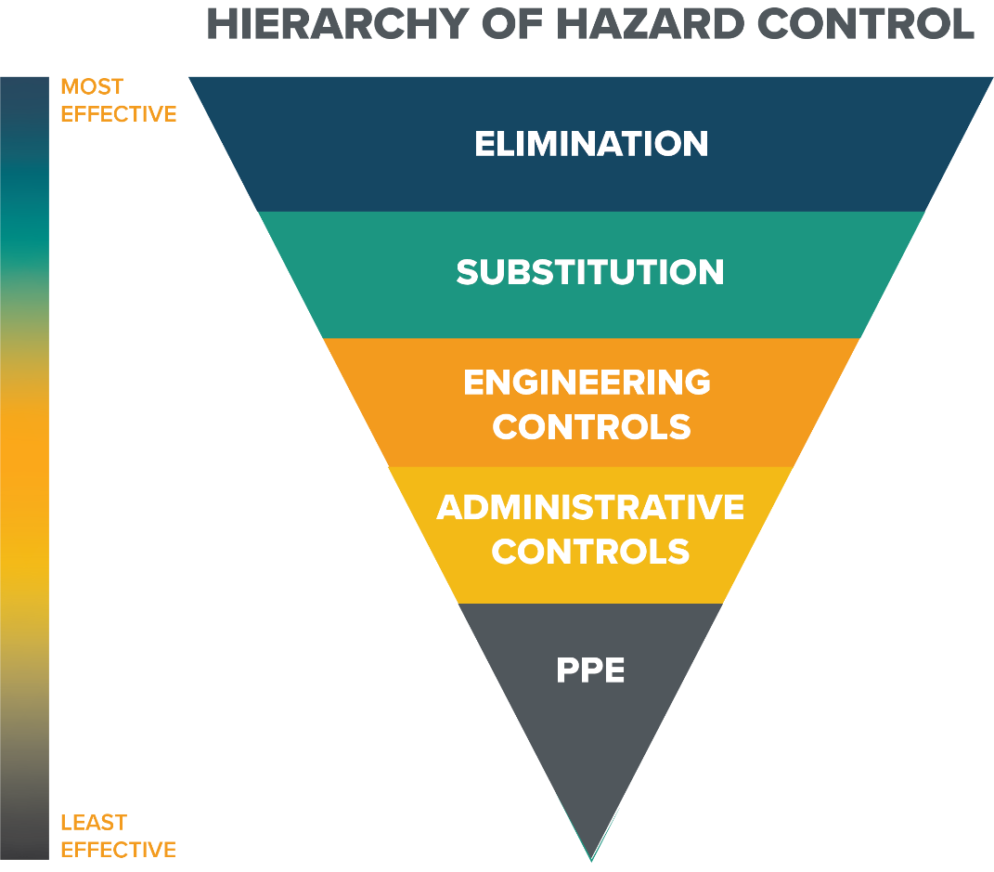
Infection Prevention -Hierarchy of Controls
Example: Vaccination
Example: substitution of detergent to disinfectant to kill environmental contamination
Example: air handling systems – negative pressure room
Example: Isolation of a patient with a communicable disease

Slide 10
PPE is
A variety of barriers used alone or in combination to protect mucous membranes, eyes, skin, and clothing from contact with infectious agents and blood/body substances
Includes equipment such as gloves, Apron or gowns, eye protection (safety glasses, goggles, face shield) and masks
PPE needs to be:
suitable for the nature of the work
a proper size and fit for the person
properly stored and maintained
If reusable – cleaned and/or disinfected after use and according to the manufacturer’s instructions
Used according to the manufacturer’s instructions
PPE must meet Australian Standards and where applicable Therapeutic Goods Administration (TGA) requirements
Personal protective equipment (PPE) SafeWork NSW

Slide 11
PPE for infection prevention
PPE is worn for standard and/or transmission based precautions:
When there is risk of exposure to blood and body substances
When caring for patients, or in a healthcare environment where there is a risk of transmission of pathogenic microorganism or communicable disease
Hand hygiene is an integral part of standard precautions. It is not PPE but must be performed in the steps for donning, doffing and changing PPE. It prevents contamination of the PPE and contamination of person when removing PPE

Slide 12
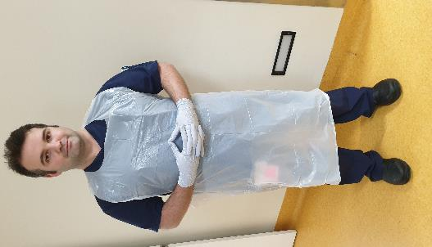
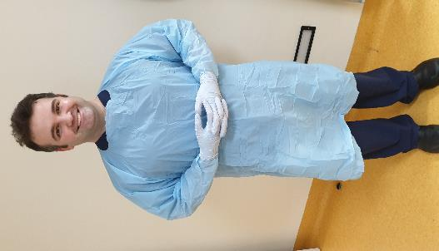
PPE for Contact Precautions
Close contact
Apron + Gloves The minimum requirement when providing care (close contact)
or
Gown + Gloves
A gown may be required if expected to provide close and prolonged care

Slide 13
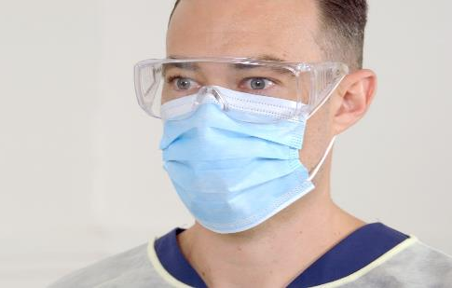
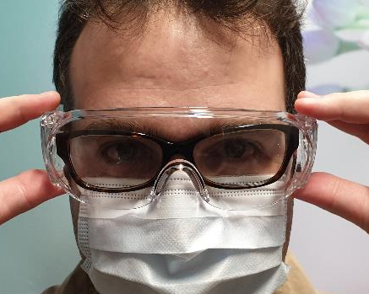
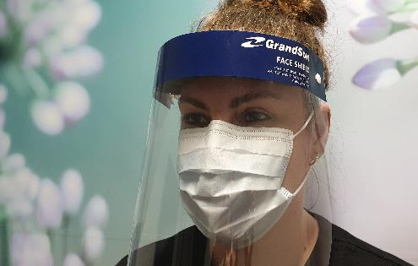
PPE for Droplet Precautions
based on Risk Assessment choose either
Eye protection
Surgical Mask
If prescription glasses are worn, eye protection must fit over glasses
Note: prescription glasses are not designed to protect the wearer from exposure to splash and fluid from blood and body substances.

Slide 14
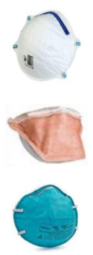
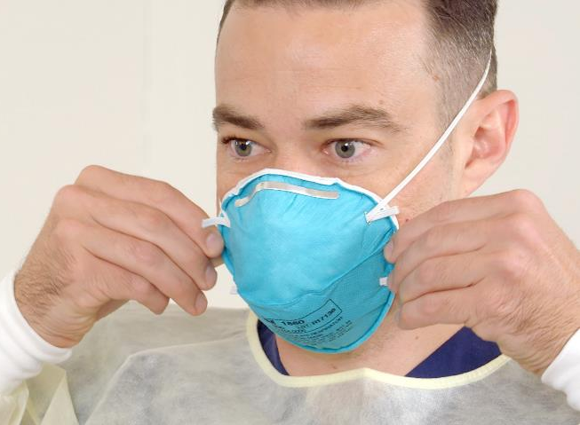
PPE for Airborne Precautions
P2/N95 masks come in different shapes and colours.
Local supply and availability may vary.
Note the different mask for droplet and airborne precautions: remember, how transmission or movement of microorganisms occurs?
What differences can you spot between the two masks (surgical and P2/N95 masks)?

Slide 15
PPE and risk assessment
Deciding on when and what PPE to apply
Consider the transmission route of any suspected/confirmed microorganism or communicable disease (contact, droplet & or airborne)
Think about the task and or procedure to be completed;
Is there anticipated exposure to blood and or body substances?
How likely is it there will be exposure to blood and or body substances?
What is the estimated duration of the exposure risk?
Using the responses, consider PPE usage in line with Infection Prevention practices for standard or transmission based precautions.
Always observe transmission based precautions signage for PPE guidance if there is uncertainty.
 | Standard | Contact | Droplet | Airborne
Blood or body substance contact anticipated | ✓
Symptoms such as skin infections, MRO colonisation, diarrhoea, | ✓ | ✓
Respiratory symptoms such as cough, coryza, SOB +/- fever. Suspected or confirmed influenza or COVID-19 mild/moderate symptoms and there is no Aerosol Generating Procedure (AGP) | ✓ |  | ✓
Suspected or confirmed Tuberculosis, measles, varicella, or suspected or confirmed COVID-19 with significant symptoms, or when AGPs done | ✓ |  |  | ✓
A combination of these different levels of precautions will be applied in certain situations depending of the mode of transmission of the pathogen. For example COVID-19 patient and AGPs requires Contact + Droplet + Airborne | ✓ | ✓ | ✓ | ✓
National Health and Medical Research Council
Infection Prevention and Control Practice Handbook National Standard 3

Slide 16
Donning PPE for combined contact and droplet precautions in addition to standard precautions
Note: Combining transmission based precautions, like contact and droplet precautions is needed for some infectious diseases such as COVID-19.
Where respiratory aerosol generating procedures (AGP) are performed on COVID-19 case, combined contact, droplet and airborne precautions are needed; refer to the CEC YouTube channel.

Slide 17
Sequence for donning PPE
Perform hand hygiene
Put on gown/apron
Put on mask
Put on eye protection
Perform hand hygiene
Put on gloves

Slide 18
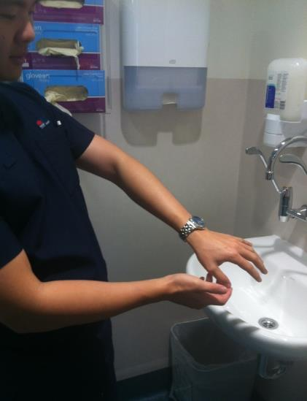
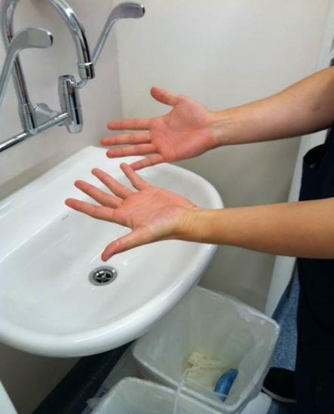
Remove items before hand hygiene
Remove rings, watches, etc. that will interfere with effective hand hygiene, and roll up your sleeves
Note: Nail polish, artificial and false nails must not be worn in clinical environments.
Artificial or false nails continue to demonstrate increased opportunity for transmitting pathogenic microorganisms.
NSW Health Infection Prevention and Control Policy

Slide 19
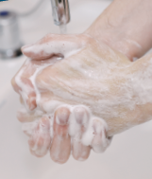
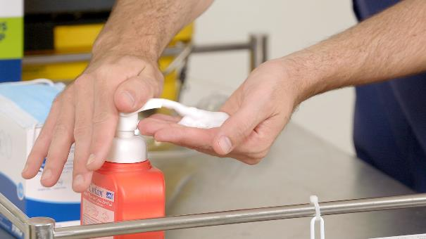
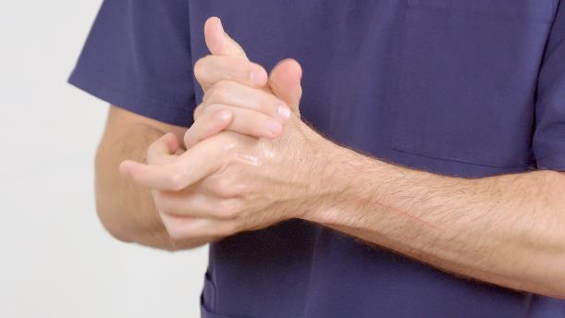
Perform hand hygiene
Clean hands with:
alcohol based hand rub (ABHR) in either liquid, foam or gel form; or
antiseptic liquid hand wash and running water; or
(plain) liquid soap and running water and dry with single use towels
Note: manufacturers of ABHR solutions state the amount of solution delivered per pump dispenser action and how much solution is required per hand hygiene moment.
National Hand Hygiene Initiative
Infection Prevention and Control Practice Handbook

Slide 20
Sequence for donning PPE
Perform hand hygiene
Put on gown/apron
Put on mask
Put on eye protection
Perform hand hygiene
Put on gloves

Slide 21
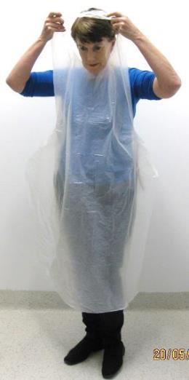
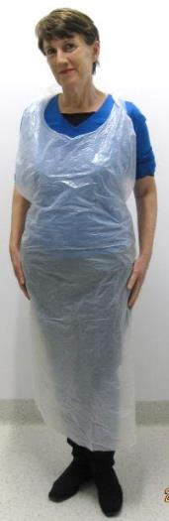
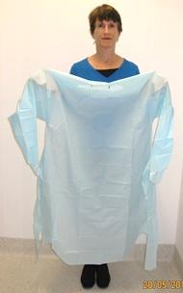
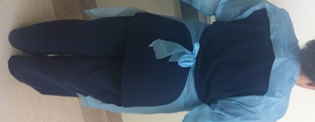
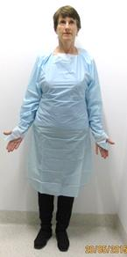
Put on Gown or Apron
1. Bare below elbows
2. Open the apron without it touching any surfaces such as floor or wall
3. Ties secured at the waist at the back
1. Open the gown without it touching any surfaces such as floor or wall
2. Ties secured at the waist at the back
3. Thumb hooks (some gowns) over the thumb
Note: the tie for both styles is secured at the back
Gowns & aprons come in different shapes and colours.
Local supply and availability may vary.

Slide 22
Sequence for donning PPE
Perform hand hygiene
Put on gown/apron
Put on mask
Put on eye protection
Perform hand hygiene
Put on gloves

Slide 23
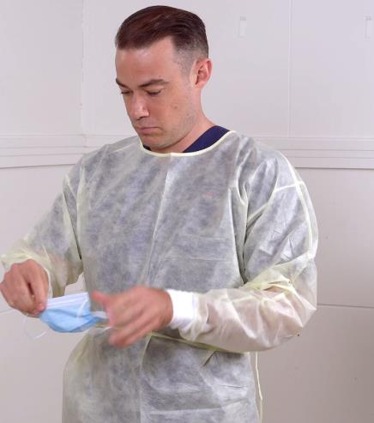
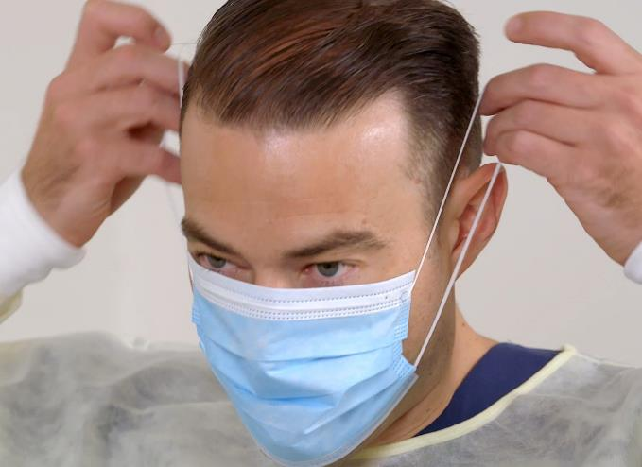
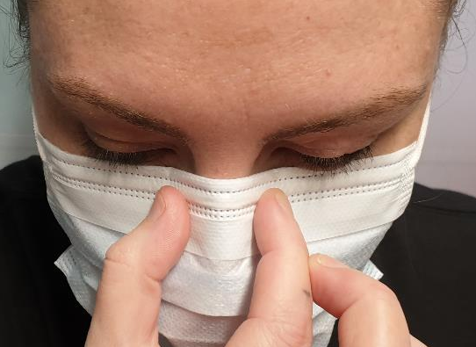
Surgical masks for droplet precautions
Handle the mask by the straps only
2. Secure loops behind the ears
3. Mould the nose piece to fit your face
Notes:
Option 1

Slide 24
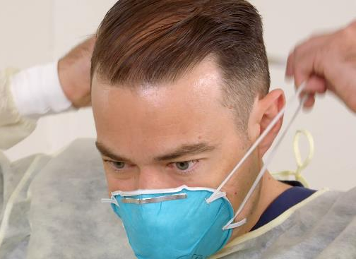

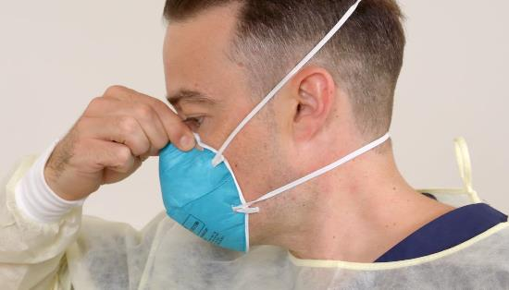
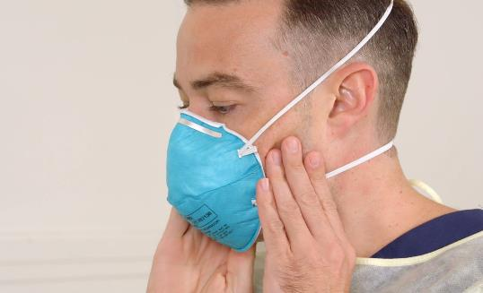
P2/N95 masks for airborne precautions
Put on a P2 or N95 mask to cover your nose and mouth.
You should perform a fit check immediately after donning the mask. Breathe in and out to check that air is not escaping and the mask fits you well.
Note: Do not be confused with fit testing and fit checking. Fit checking is a safety measure performed at the time of donning the P2/N95 mask prior to the airborne exposure risk.

Slide 25
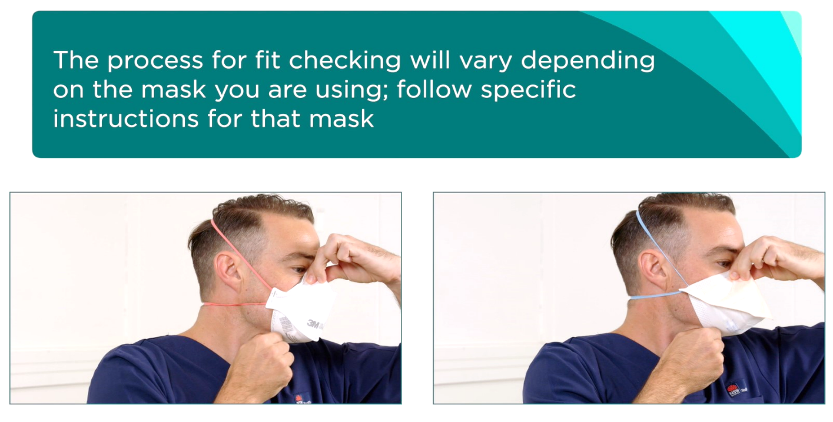
P2/N95 masks for airborne precautions
Fit-checking-chart-2020.pdf

Slide 26
Sequence for donning PPE
Perform hand hygiene
Put on gown/apron
Put on mask
Put on eye protection
Perform hand hygiene
Put on gloves

Slide 27
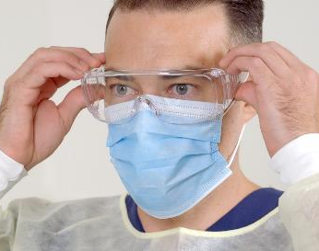

Eye protection
Ensure eye protection
is secure
doesn’t need adjustment after applying
Note: Eye protection is designed to protect the wearer from exposure to splash and fluid from blood and body substances. Prescription glasses are not designed for this purpose. Protecting your prescription glasses will protect your eyes from exposure risks.

Slide 28
You are now ready to enter the patient’s room or zone
Note: take a moment and observe for any isolation signage communicating infection control precautions. Use this opportunity to confirm the appropriate PPE is in place.
Depending on your work location (e.g. in the client’s home) this slide may not be relevant.

Slide 29
Sequence for donning PPE
Perform hand hygiene
Put on gown/apron
Put on mask
Put on eye protection
Perform hand hygiene
Put on gloves

Slide 30
Perform hand hygiene
Clean hands with:
alcohol based hand rub (ABHR) in either liquid, foam or gel form; or
antiseptic liquid hand wash and running water; or
(plain) liquid soap and running water and dry with single use towels
Note: Did you know all manufacturers of ABHR solutions state the amount of solution delivered per pump dispenser action and how much solution is required per hand hygiene moment?
National Hand Hygiene Initiative
Infection Prevention and Control Practice Handbook

Slide 31
Sequence for donning PPE
Perform hand hygiene
Put on gown/apron
Put on mask
Put on eye protection
Perform hand hygiene
Put on gloves

Slide 32
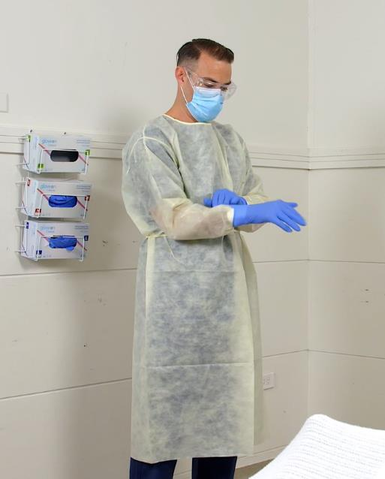
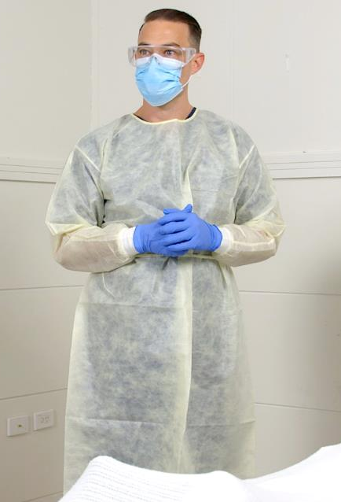
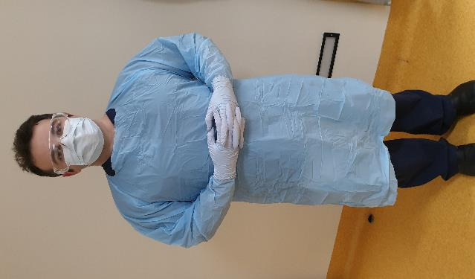
Gloves
don immediately before touching the patient
Note: When wearing a gown the gloves should cover the cuffs of the gown.

Slide 33
You have now completed the steps to don PPE

Slide 34
Additional information
Head covers are used only in theatre/procedural settings to protect the patient & environment from health workers’ skin and hair particles – NOT considered PPE
Shoe covers are used in some theatre settings to reduce contamination of theatre floor & protect the shoes of staff – NOT considered PPE
Powered-Air Purifying Respirator (PAPR) – a battery-powered blower that provides positive airflow through a filter, cartridge, or canister to a hood or face piece; may be used if a health worker has to stay in the patient’s room continuously for a long period (more than 1 hour) to perform multiple procedures, or for additional comfort and visibility.

Slide 35
Remember when the PPE is on:
Avoid touching your face, including the mask
Avoid touching or adjusting other PPE during care provision
Change gloves when torn or heavily contaminated
Limit surfaces and items touched to prevent accidental contamination of gloves
Masks are not worn around the neck or under the chin.
Note: remember, when changing gloves, hand hygiene still needs to be performed.

Slide 36
Doffing (Removing) PPE
for combined contact and droplet precautions in addition to standard precautions
Note: Combining transmission based precautions, like contact and droplet precautions is needed for some infectious diseases such as COVID-19.
Where respiratory aerosol generating procedures (AGP) are performed, combined contact, droplet and airborne precautions are needed; refer to the CEC YouTube channel.

Slide 37
Doffing (Removing) PPE
Remove and discard PPE:
Away from the immediate patient environment
Into general waste unless heavily contaminated by blood and or body substances
If the patient/client is in a single room:
remove gloves and gown – before leaving the patient’s room – hand hygiene
eye protection and mask – is removed immediately outside patient’s room/zone,
for airborne precautions, remove mask after the door to patient’s room has been closed (on exit)
Hand hygiene facilities (soap and water, or alcohol based hand rub) should be readily available for use at the location of doffing PPE.
Note: some environments may have designated areas for donning and doffing of PPE. Regardless, it is important that you move away from the immediate patient environment before removing PPE.

Slide 38
Sequence for Removing PPE
The sequence for removing PPE aims to limit opportunities for self contamination and further environmental contamination. When using reusable eye protection perform hand hygiene after cleaning.
Remove gloves OR Remove gown and gloves in one step
Perform hand hygiene
Remove gown Perform hand hygiene
Perform hand hygiene Remove eye protection
Remove eye protection Remove mask
Remove mask Perform hand hygiene
Perform hand hygiene
Removing gown and gloves in one step is only performed if you have had training. CEC YouTube channel
Hand hygiene must be performed if hands become contaminated at any step, and always after removing gloves

Slide 39
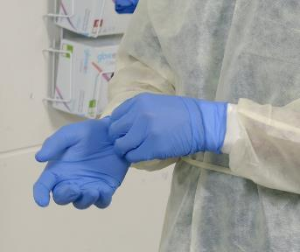
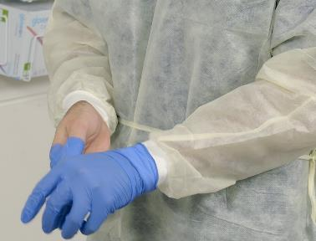
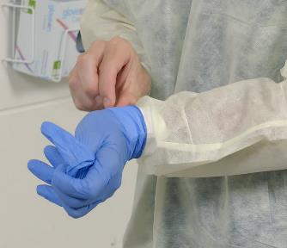
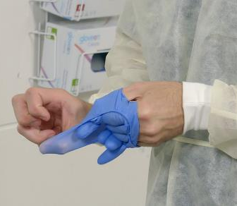
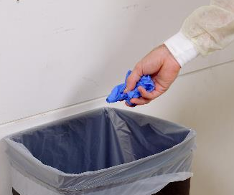
Remove gloves
Care is taken to avoid contaminating the hands
Dirty to dirty – pinch outside of glove
Peel first glove off and hold it with your gloved hand
Clean to clean – slip clean finger UNDER the remaining glove
Peel glove off, rolling it over the top of the held glove
Dispose of gloves in the correct waste bin

Slide 40
Sequence for Removing PPE
The sequence for removing PPE aims to limit opportunities for self contamination and further environmental contamination. When using reusable eye protection perform hand hygiene after cleaning.
Remove gloves OR Remove gown and gloves in one step
Perform hand hygiene
Remove gown Perform hand hygiene
Perform hand hygiene Remove eye protection
Remove eye protection Remove mask
Remove mask Perform hand hygiene
Perform hand hygiene
Removing gown and gloves in one step is only performed if you have had training. CEC YouTube channel
Hand hygiene must be performed if hands become contaminated at any step, and always after removing gloves
Clinical Excellence Commission
40

Slide 41
Perform hand hygiene

Slide 42
Sequence for Removing PPE
The sequence for removing PPE aims to limit opportunities for self contamination and further environmental contamination. When using reusable eye protection perform hand hygiene after cleaning.
Remove gloves OR Remove gown and gloves in one step
Perform hand hygiene
Remove gown Perform hand hygiene
Perform hand hygiene Remove eye protection
Remove eye protection Remove mask
Remove mask Perform hand hygiene
Perform hand hygiene
Removing gown and gloves in one step is only performed if you have had training. CEC YouTube channel
Hand hygiene must be performed if hands become contaminated at any step, and always after removing gloves

Slide 43

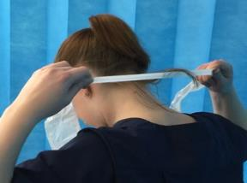
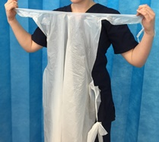
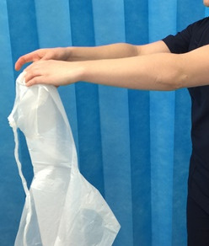
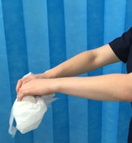
Option 1 – Remove apron
1. Break or undo ties
2. Break neck strap
Hold apron away from yourself, touching the inside of apron only, fold apron in on itself and roll up

Slide 44
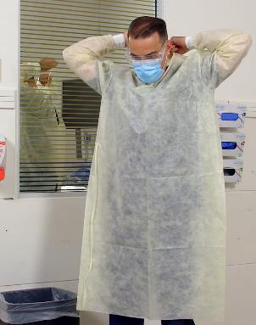
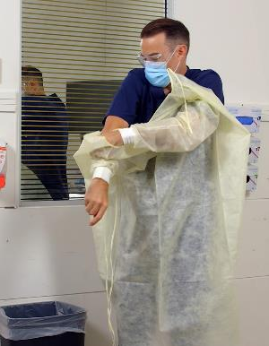
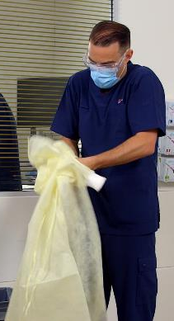
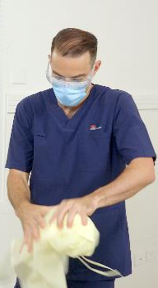
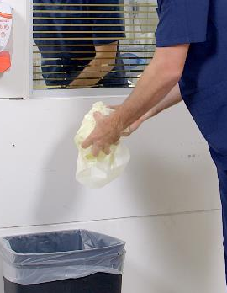
Option 1 – Remove apron
Untie the gown
Pull the gown away from you
Roll it inwards and downwards. Make sure you bend forward slightly to reduce self-contamination
Discard the gown into the general waste bin

Slide 45
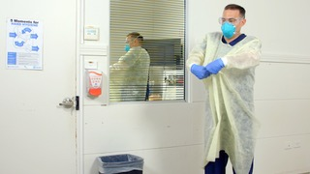
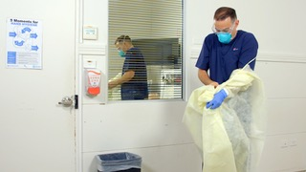
Option 2 – Remove gown and gloves
In one sequence
With gloved hands, grab and pull the gown from your chest to break the ties in a controlled manner.
Continue to pull the gown and at the same time roll the gown inwards and down your arms, removing the gloves along with the sleeves of the gown.
Continue to roll and dispose of the gown using the same steps as the previous slide.
Note: this is only an option for health workers that have been trained and are competent at removing their gown and gloves in one step.

Slide 46
Sequence for Removing PPE
The sequence for removing PPE aims to limit opportunities for self contamination and further environmental contamination. When using reusable eye protection perform hand hygiene after cleaning.
Remove gloves OR Remove gown and gloves in one step
Perform hand hygiene
Remove gown Perform hand hygiene
Perform hand hygiene Remove eye protection
Remove eye protection Remove mask
Remove mask Perform hand hygiene
Perform hand hygiene
Removing gown and gloves in one step is only performed if you have had training. CEC YouTube channel
Hand hygiene must be performed if hands become contaminated at any step, and always after removing gloves

Slide 47
Perform hand hygiene

Slide 48
Sequence for Removing PPE
The sequence for removing PPE aims to limit opportunities for self contamination and further environmental contamination. When using reusable eye protection perform hand hygiene after cleaning.
Remove gloves OR Remove gown and gloves in one step
Perform hand hygiene
Remove gown Perform hand hygiene
Perform hand hygiene Remove eye protection
Remove eye protection Remove mask
Remove mask Perform hand hygiene
Perform hand hygiene
Removing gown and gloves in one step is only performed if you have had training. CEC YouTube channel
Hand hygiene must be performed if hands become contaminated at any step, and always after removing gloves

Slide 49
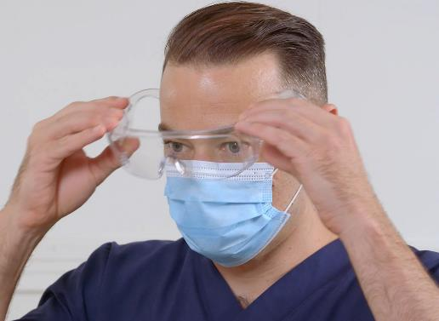
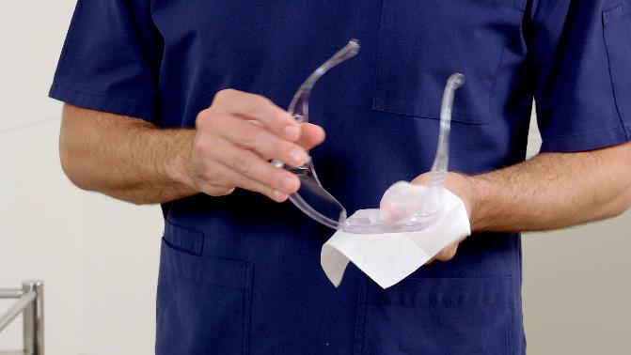
Remove eye protection
Remove eye protection when outside patient’s room/zone
Remove goggles or face shield by handling the back strap or sides only
Dispose of single use eye protection in waste
Place reusable eye protection in designated receptacle for cleaning and disinfection and / or follow routine processes. Then perform hand hygiene

Slide 50
Sequence for Removing PPE
The sequence for removing PPE aims to limit opportunities for self contamination and further environmental contamination. When using reusable eye protection perform hand hygiene after cleaning.
Remove gloves OR Remove gown and gloves in one step
Perform hand hygiene
Remove gown Perform hand hygiene
Perform hand hygiene Remove eye protection
Remove eye protection Remove mask
Remove mask Perform hand hygiene
Perform hand hygiene
Removing gown and gloves in one step is only performed if you have had training. CEC YouTube channel
Hand hygiene must be performed if hands become contaminated at any step, and always after removing gloves

Slide 51
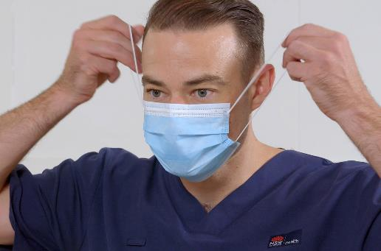
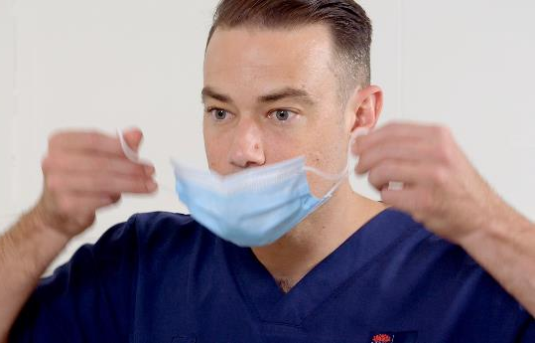
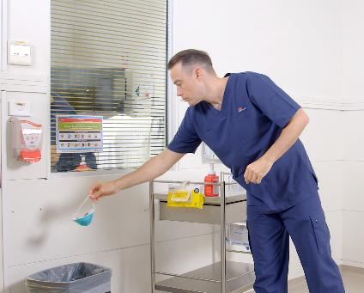
Removing surgical mask
Remove mask when outside patient’s room
Untie mask, touching ties only, front of mask is contaminated
Hold the mask away from yourself
Dispose of in the correct waste bin
Note: to remove the mask, the front of the mask is not touched.

Slide 52



Removing N95/P2 mask
Remove mask when outside patient’s room
Remove the N95 / P2 by handling the straps only.
Hold the 2 straps at the same time, and lift forward off your head.
Hold the dirty mask away from yourself, and place it in the correct waste bin
Note: to remove the mask, the front of the mask is not touched.
Clinical Excellence Commission
52

Slide 53
Sequence for Removing PPE
The sequence for removing PPE aims to limit opportunities for self contamination and further environmental contamination. When using reusable eye protection perform hand hygiene after cleaning.
Remove gloves OR Remove gown and gloves in one step
Perform hand hygiene
Remove gown Perform hand hygiene
Perform hand hygiene Remove eye protection
Remove eye protection Remove mask
Remove mask Perform hand hygiene
Perform hand hygiene
Removing gown and gloves in one step is only performed if you have had training. CEC YouTube channel
Hand hygiene must be performed if hands become contaminated at any step, and always after removing gloves

Slide 54
Perform hand hygiene

Slide 55
You have now completed the steps to doff PPE

Slide 56
For further information
CEC website: http://www.cec.health.nsw.gov.au/
CEC COVID-19 page: http://www.cec.health.nsw.gov.au/keep-patients-safe/COVID-19
CEC COVID-19 External resources: http://www.cec.health.nsw.gov.au/keep-patients-safe/COVID-19/external-resources-and-links
CEC COVID-19 PPE Training videos: http://www.cec.health.nsw.gov.au/keep-patients-safe/COVID-19/Personal-Protective-Equipment-PPE/covid-19-training-videos
NSW Health COVID-19 page: https://www.health.nsw.gov.au/Infectious/diseases/Pages/coronavirus.aspx
CEC Infection Prevention and Control Practice Handbook
National Health and Medical Research Council Australian Guidelines for the Prevention and Control of Infection in Healthcare (2019)
The NSQHS Standards: National Standard 3

Slide 57
References
CEC COVID-19 PPE Training videos: http://www.cec.health.nsw.gov.au/keep-patients-safe/COVID-19/Personal-Protective-Equipment-PPE/covid-19-training-videos
CEC.health.nsw.gov.au. 2020. [online] Available at: <http://www.cec.health.nsw.gov.au/__data/assets/pdf_file/0010/383239/IPC-Practice-Handbook-2020.PDF> [Accessed 24 April 2020].
www1.health.nsw.gov.au. 2020. [online] Available at: <https://www1.health.nsw.gov.au/pds/ActivePDSDocuments/PD2017_013.pdf> [Accessed 24 April 2020].
NHMRC.gov.au. 2020. Australian Guidelines For The Prevention And Control Of Infection In Healthcare (2019) | NHMRC. [online] Available at: <https://www.nhmrc.gov.au/about-us/publications/australian-guidelines-prevention-and-control-infection-healthcare-2019> [Accessed 24 April 2020].
Safetyandquality.gov.au. 2020. Australian Infection Prevention And Control Guidelines | Australian Commission On Safety And Quality In Health Care. [online] Available at: <https://www.safetyandquality.gov.au/our-work/healthare-associated-infection/national-infection-control-guidelines> [Accessed 24 April 2020].

Slide 58
For any questions and clarification contact the local Infection Prevention & Control team

